Slide 1
Engineering Probability & Statistics
GROUP 02
ANALYZING SALES PATTERN OF A SUPERSTORE
Advait Jigarbhai Naik Ajinkya Vitthalrao Jadhav
Bhumika Channakeshava Rushil Vijayan
Saloni Vivek Tanpure Shivendra Chandrashekhar Jagtap

Slide 2
Outline
Problem Statement
1
Project Goals
2
Data Visualization
3
4
Statistical Analysis
5
Conclusion

Slide 3

Problem Statement
Using superstore sales data, we analyze seasonal trends, demand patterns, and profitability to help businesses optimize resources and improve efficiency
Project Goals
Identify seasonal sales trends and demand patterns using superstore data.
Analyze product profitability to guide strategic decisions.
Compare regional sales performance to improve resource allocation.
Optimize regional distribution for enhanced customer satisfaction.

Slide 4
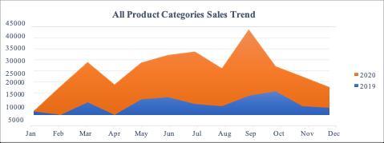
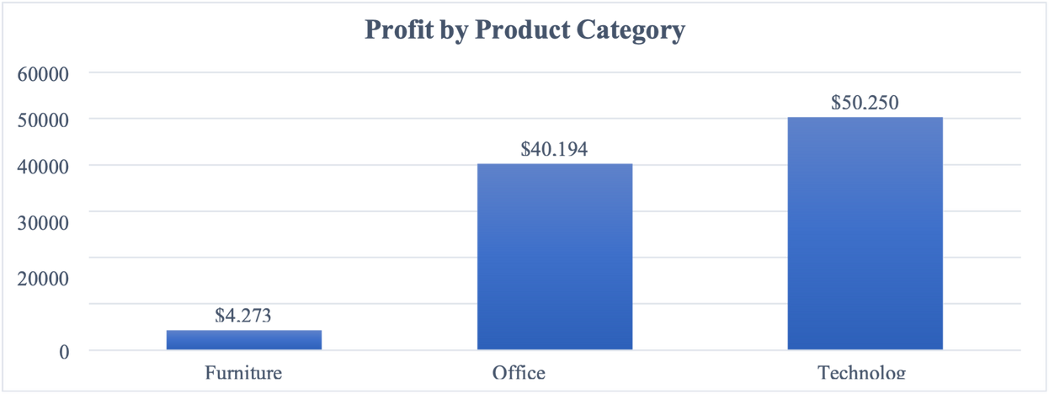
DATA VISUALIZATION
Sharp sales rise in Sept 2020 likely due to COVID-driven demand
Technology leads profit
Office Supplies follow

Slide 5
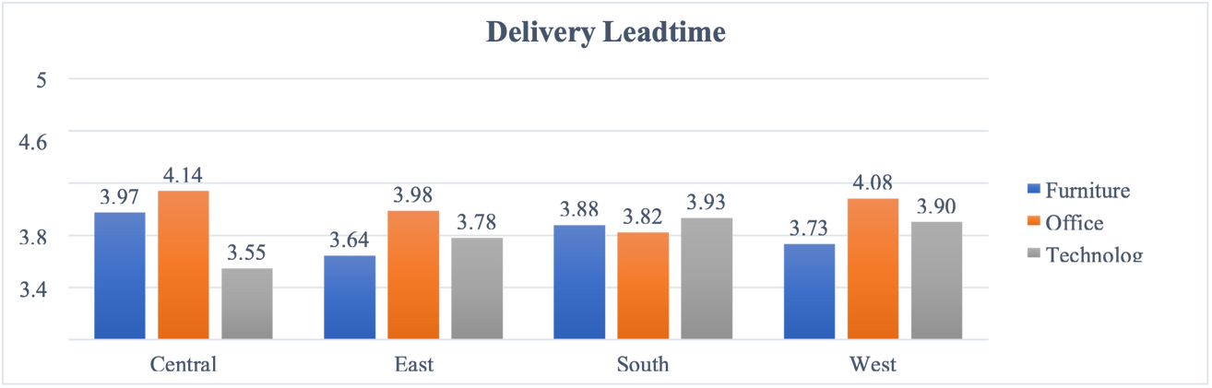
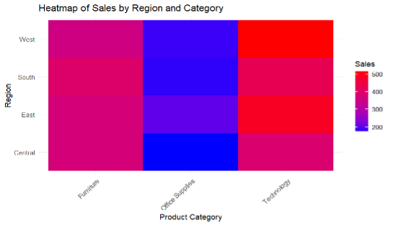
DATA VISUALIZATION
Office Supplies have the longest lead time, especially in Central
West dominates sales
Central and South underperform

Slide 6
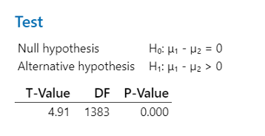
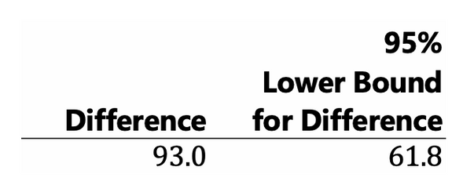
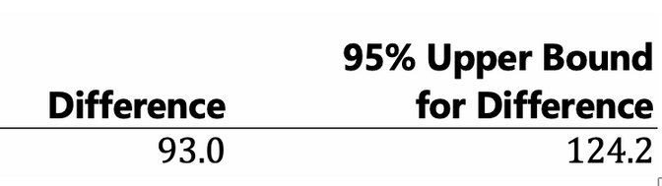
STATISTICAL ANALYSIS
1
Two Sample T-Test (Year Wise Sales Trend)
Compared 2019 and 2020 sales to test if 2020 had higher sales.
Null hypothesis: No difference in mean sales;
alternative hypothesis: 2020 sales are higher.
P-value: 0.000, rejecting the null hypothesis.
95% confidence interval for the mean difference: (61.8, 124.2).
Concluded that 2020 sales were significantly higher, likely due to COVID-19-driven demand.

Slide 7
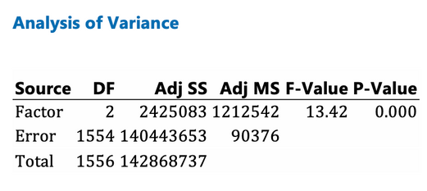
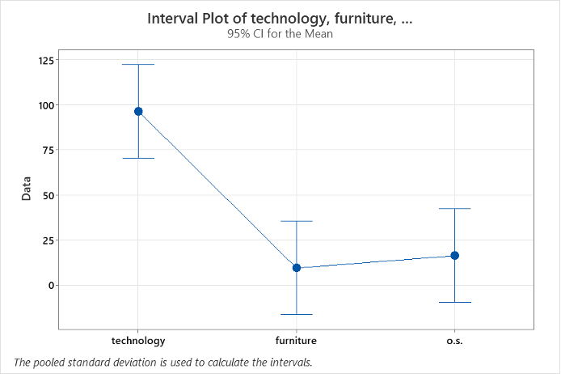
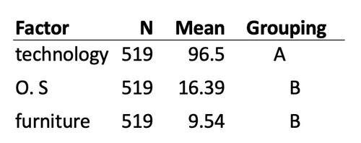
STATISTICAL ANALYSIS
ANOVA Analysis (Category wise Profit)
2
Performed ANOVA to compare profit across product categories (Technology, Furniture, Office Supplies).
Null hypothesis: All category means are equal; alternative hypothesis: Means are not equal.
P-value: 0.000, rejecting the null hypothesis.
Technology has significantly higher profit than Furniture and Office Supplies.
Suggests the need for targeted strategies for low-performing categories.

Slide 8
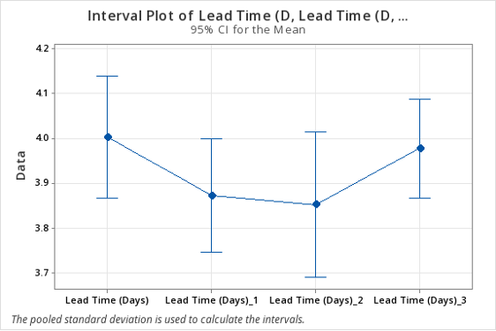
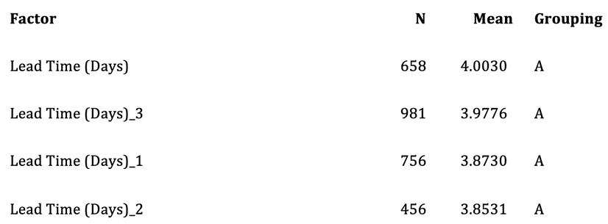
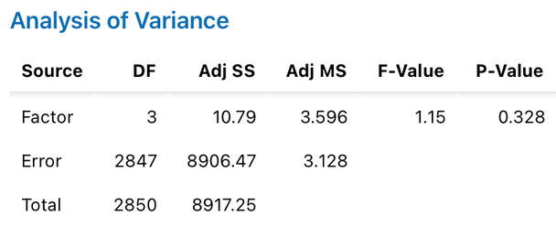
STATISTICAL ANALYSIS
3
ANOVA Analysis (Leadtime Across Regions)
Conducted ANOVA to compare lead times across four regions (Central, East, South, West).
Null hypothesis: All region lead times are equal; alternative hypothesis: Lead times differ by region.
P-value: 0.328, failing to reject the null hypothesis.
No significant differences in lead times across regions, indicating consistent performance.

Slide 9
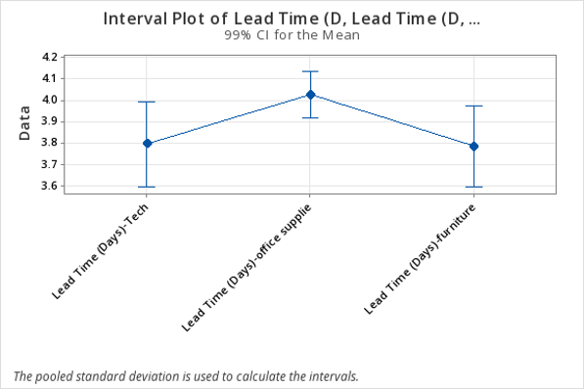
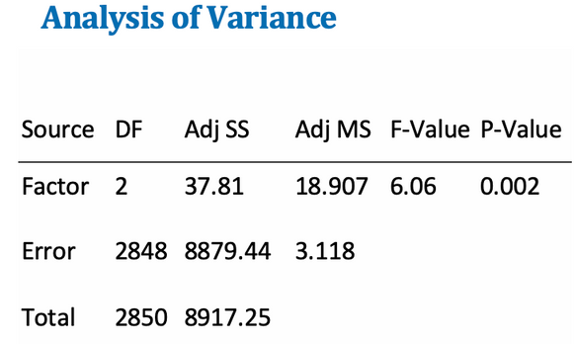
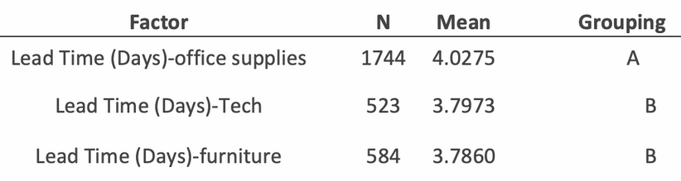
STATISTICAL ANALYSIS
4
ANOVA Analysis (Leadtime Per Category)
Conducted ANOVA to compare lead times for Technology, Furniture, and Office Supplies.
Null hypothesis: All category lead times are equal; alternative hypothesis: Lead times differ by category.
P-value: 0.002, rejecting the null hypothesis.
Office Supplies have significantly longer lead times than Technology and Furniture.
Suggests inefficiencies in the Office Supplies supply chain.

Slide 10
CONCLUSION
2020 sales significantly higher than 2019, driven likely by back-to-school season and COVID-19 demand surge (Two-sample t-test).
Technology is the most profitable category (Profit analysis using ANOVA)
No significant differences in lead times across regions, indicating consistent regional performance (ANOVA on lead times).
Office Supplies have the longest lead times, indicating logistics inefficiencies (ANOVA on lead times).

Slide 11


